Slide 1


Australian Road Fatalities
Scyne advisory
Data Insights & Recommendations
Noorullah khan

Slide 2
EXECUTIVE SUMMARY
Fatal crashes have declined long-term but plateaued in recent years.
Weekends and late-night hours remain the highest-risk windows.
Young male drivers are disproportionately involved in fatal crashes.
Risks differ across environments: single-vehicle crashes dominate at high speed/night; multi-vehicle crashes peak in commuting hours.
Holiday periods mirror these risks, especially late-night driving, without adding new patterns.

Slide 3




Aim & Hypotheses
Fatal crashes are more likely during weekends and late-night hours
Young male drivers are disproportionately involved in single-vehicle crashes.
High-speed roads see more single-vehicle crashes; multi-vehicle crashes cluster in commuting hours.
Holiday periods amplify existing late-night risks but do not introduce unique new patterns.

Slide 4


Dataset overview

Slide 5
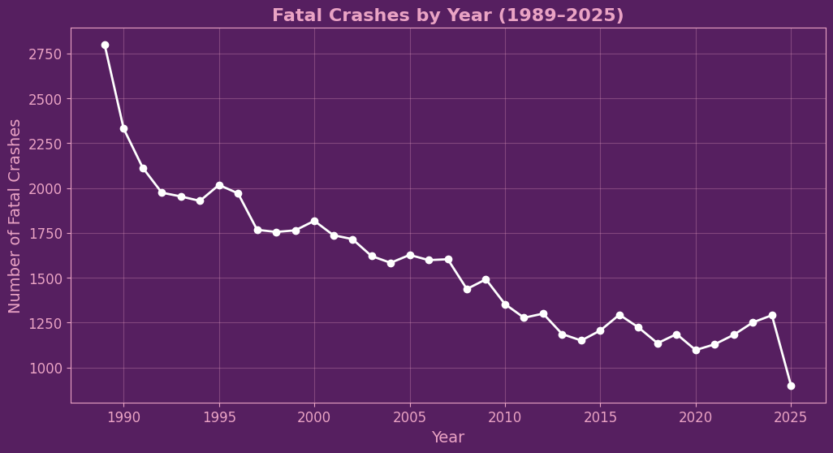
CRASH TRENDS OVER TIME
Fatal crashes declined sharply from late 1980s → mid-2010s.
Decline is remarkable given higher car ownership, more roads, and greater traffic volumes today.
Plateau since ~2020, with slight upward drift.
2025 dip is incomplete year effect (data still incoming).

Slide 6
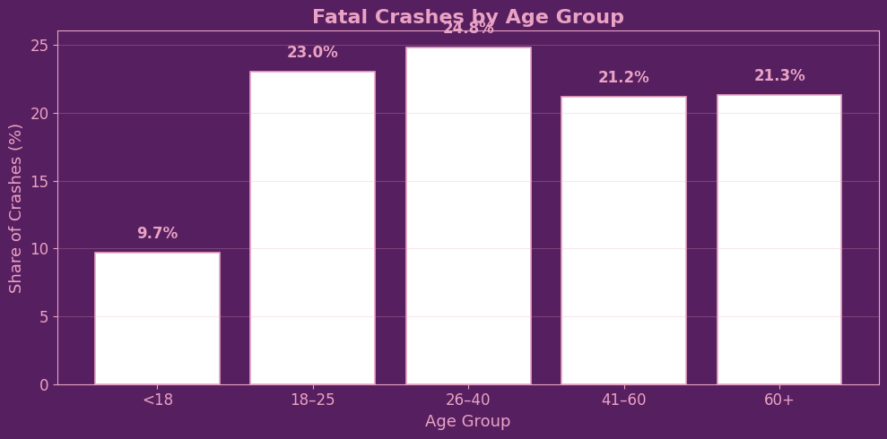
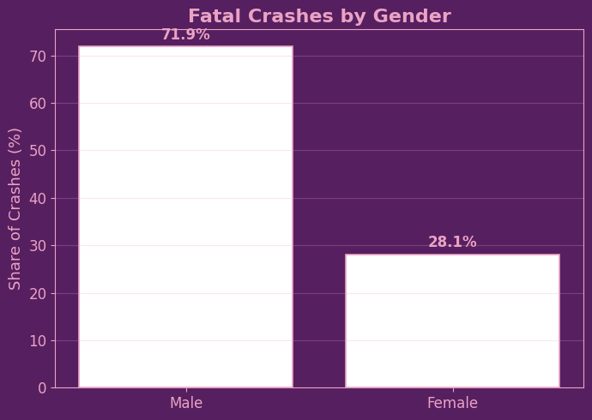
Fatal CRASH Demographics
Young adults (18–25) are heavily overrepresented given their share of the population.
Middle-aged drivers (26–40, 41–60) still contribute significantly, showing crashes aren’t only a “young driver problem.”
Gender imbalance: ~72% of fatal crashes involve male drivers vs ~28% female.
Elderly drivers (60+) show a increase, potentially due to fragility and slower reaction times.

Slide 7
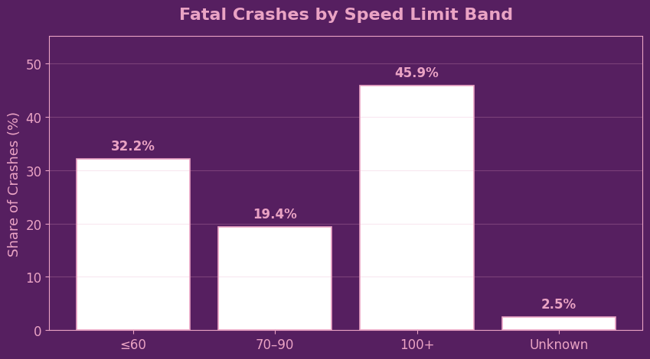
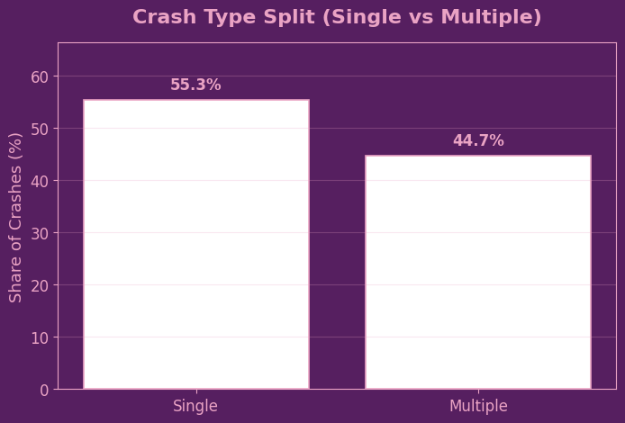
Fatal CRASH Demographics
Almost half of all fatal crashes (46%) occur on high-speed roads (100+).
Urban/commuter zones (≤60 km/h) still account for a large share (~32%), likely due to traffic density.
Single-vehicle crashes dominate (55%) → especially in high-speed or rural contexts.
Multi-vehicle crashes (45%) are still significant, concentrated in commuting/urban settings

Slide 8
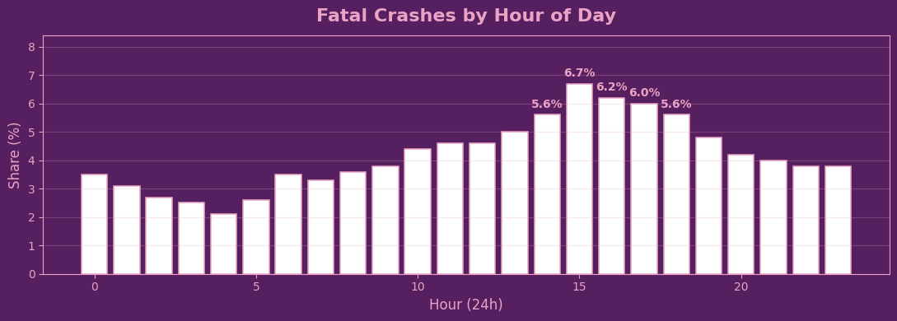
Temporal Patterns

Slide 9
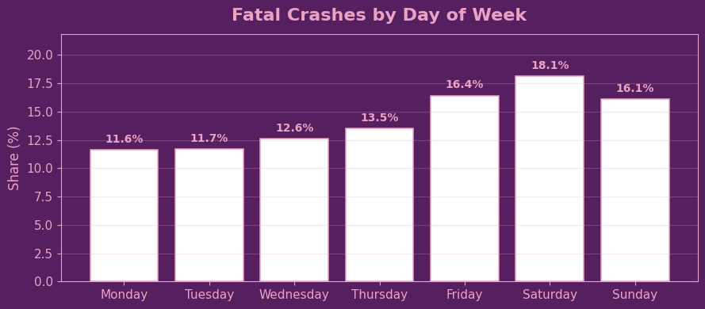
Temporal Patterns

Slide 10
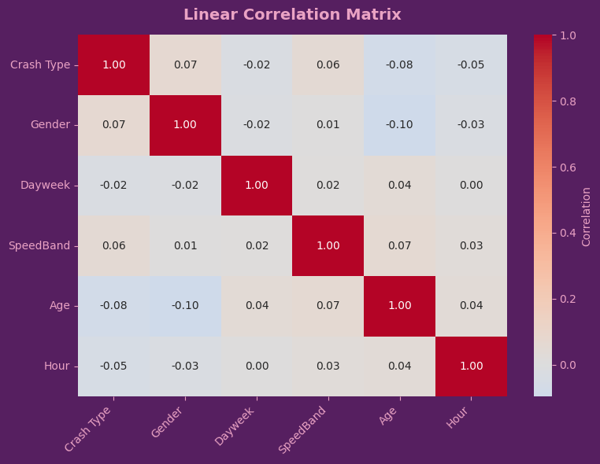
Linear relationships
LINEAR RELATIONSHIPS DON’T ALWAYS EXIST
SURFACE LEVEL ANALYSIS DOESN’T TELL THE WHOLE STORY

Slide 11
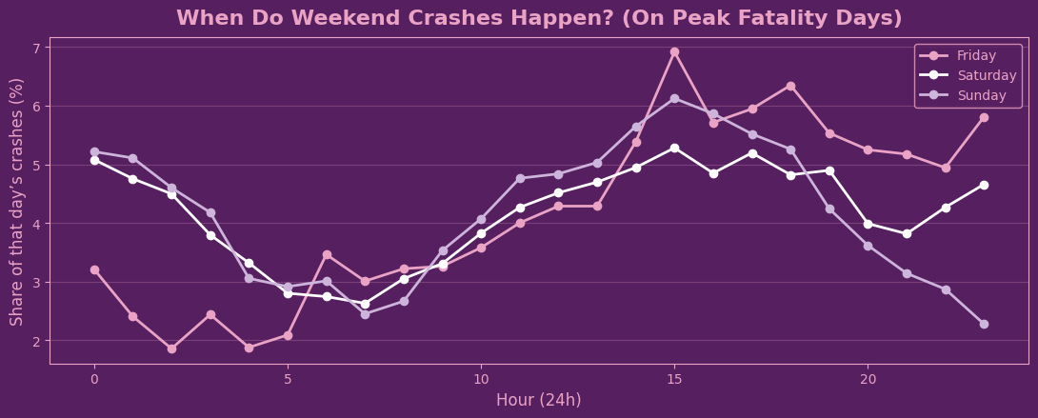
Deeper Patterns

Slide 12
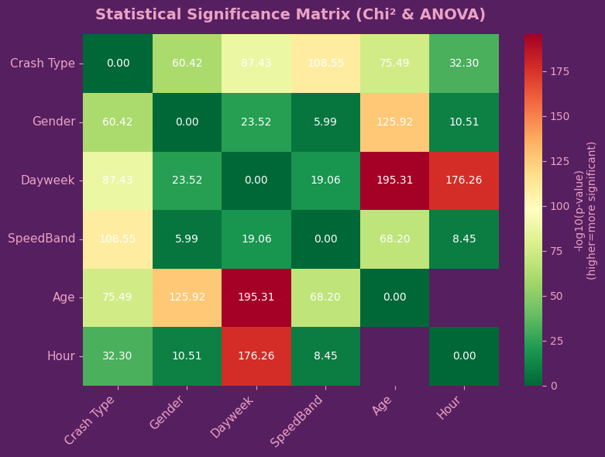
statistically significant relationships

Slide 13
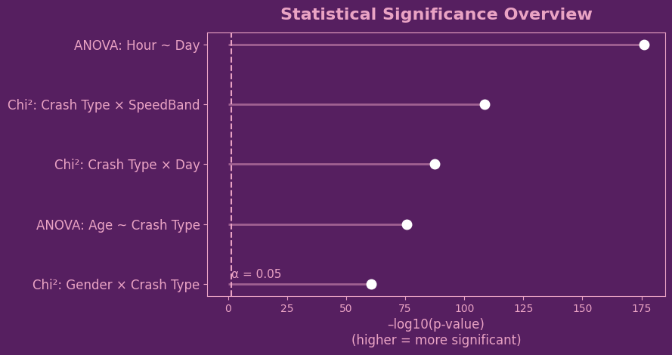
statistically significant relationships

Slide 14
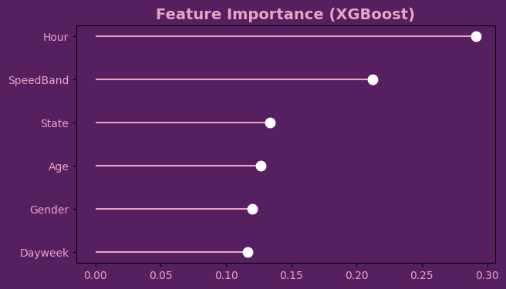
Machine learning
SHOWS SAME FACTORS AS STATISTICAL TESTS

Slide 15
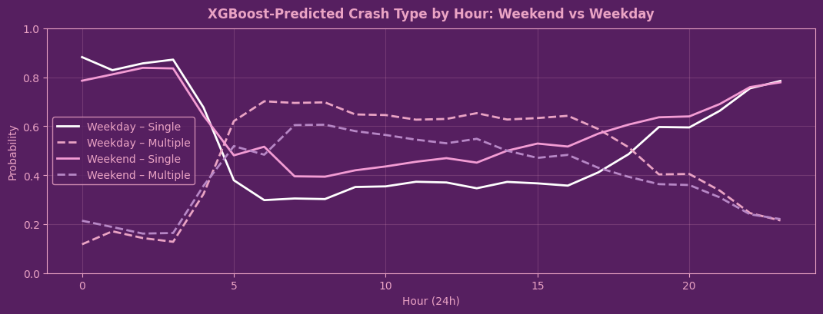
Predictions

Slide 16
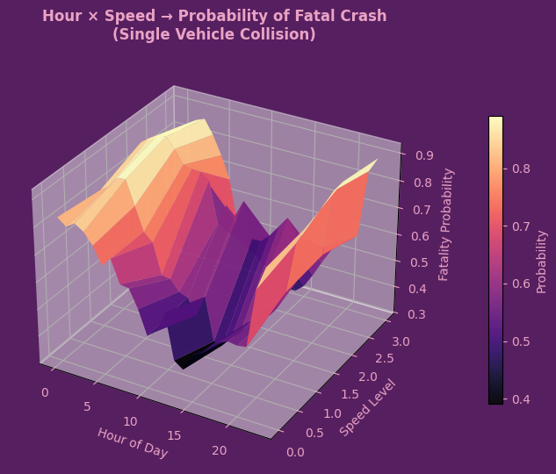
3d probability analysis
Are single crashes more likely at night on high-speed roads?

